Slide 1
LATIN AMERICAN POLITICAL DEVELOPMENT
The Importance of History in Politics.

Slide 2
HISTORICAL LEGACIES
THE INDIGENOUS ERA and the COLONIAL PERIOD.
THE DOMINANT CULTURES: THE MEXICA (AZTEC) & THE MAYA in MEXICO, AND THE INCA IN PERU; PLUS, A VARIETY OF OTHERS.
THE ARRIVAL OF THE SPANISH AND PORTUGUESE CONQUERORS IN THE 16th Century: THE MASSACRE OF THE INDIGENOUS POPULATIONS (VIOLENCE & ‘EUROPEAN ILLNESSES’).

Slide 3
HISTORICAL LEGACIES
THE INDIGENOUS ERA/COLONIALISM
INDIGENOUS POPULATIONS BECAME FORCED LABOR, MAINLY IN NEW SPAIN (MEXICO) AND PERU: THE ENCOMIENDAS & THE
REPARTIMIENTO.
The Clash of Cultures. Check this clip: https://www.youtube.com/watch?v=J5Bgsa_kBO0

Slide 4
HISTORICAL LEGACIES
THE INDIGENOUS ERA/COLONIALISM.
Economic dependency from Iberian countries was generated.
The extraction of metals was critical for the Crown of Spain; thus, New Spain and Peru became its the most important areas.
AGRICULTURE WAS ALSO AN IMPORTANT ECONOMIC ACTIVITY; THE HACIENDAS (LARGE LAND GRANTS) WERE THE PROPERTY OF THE CONQUERORS (including religious orders).
LEGAL FOREIGN TRADE WAS ONLY PERMITTED WITH SPAIN, WHOSE GOVERNMENT MICROMANAGED THE ECONOMY OF ITS COLONIES.

Slide 5
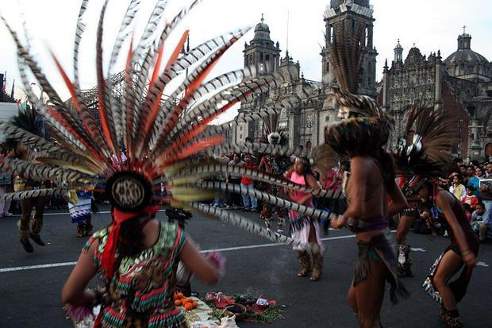
HISTORICAL LEGACIES
THE INDIGENOUS ERA/COLONIALISM.
Imposition of
Catholicism &
Religious Hybridity

Slide 6
MAP of COLONIAL LATIN AMERICA
CHECK:
http://go.grolier.com/atlas?id=mh00086

Slide 7
HISTORICAL LEGACIES
THE INDIGENOUS ERA/COLONIALISM
Type of government: VICEROYALTIES CONTROLLED BY THE REPRESENTATIVES OF THE CROWN OF SPAIN: authoritarian regime. By the way, California was part of the Viceroyalty of New Spain.

Slide 8
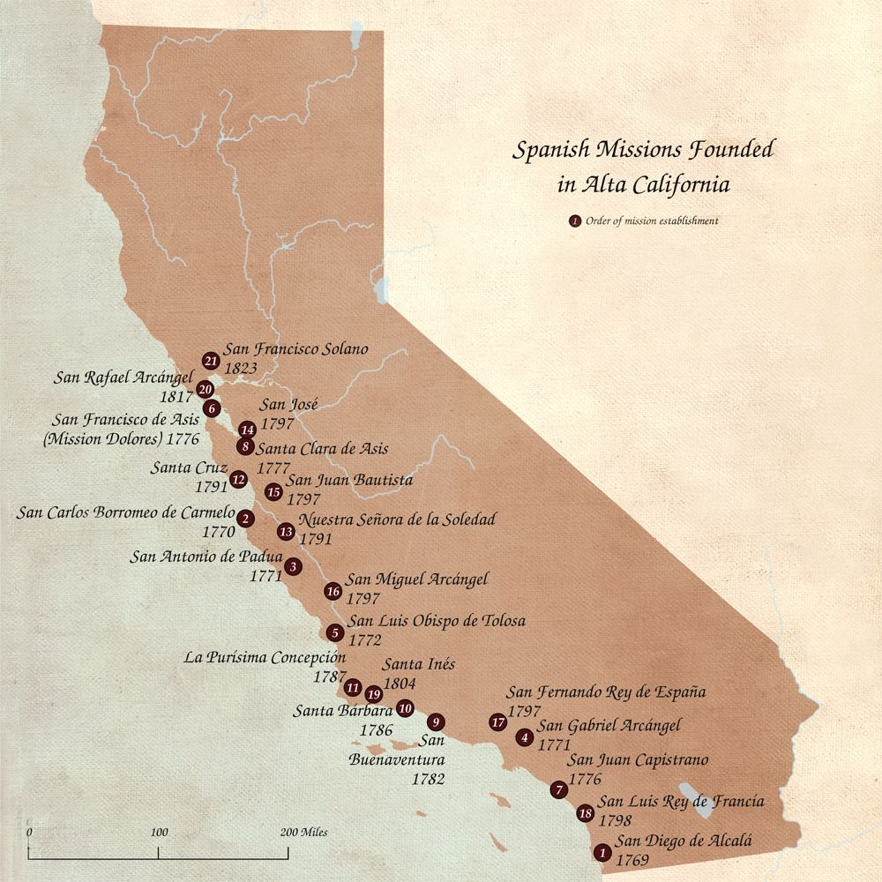
HISTORICAL LEGACIES
THE INDIGENOUS ERA/COLONIALISM

Slide 9
HISTORICAL LEGACIES
THE INDIGENOUS ERA/COLONIALISM
The pyramidal scheme of a polarized Colonial society: Peninsulares (at the top), followed by Criollos (their offspring born in the colonies), Mestizos (oneS having Spanish and indigenous descent), the Castas (mixed race), the Indigenous Populations, and the Blacks (slaves).

Slide 10
HISTORICAL LEGACIES
II. INDEPENDENCE/POST-INDEPENDENCE
INDEPENDENCE: EXTERNAL AND INTERNAL CAUSES; PARTICIPATION OF ALL SOCIETAL GROUPS; EMERGENCY OF NEW (Criollo) LEADERSHIP, e.g. Simon Bolivar in South America
The independence wars (with the exception of Brazil) left destruction of infrastructure and a high human toll that complicated the construction of the new nations.
The independent countries had to open their doors to trade and foreign invested and contracted debt.

Slide 11
HISTORICAL LEGACIES
II. INDEPENDENCE/POST-INDEPENDENCE
Various scholars used the term Neocolonialism to characterized the interchanges between the economies of the new nations of Latin America and other developed countries. The U.S. and other European countries played a key role in Northern Latin America (Mexico, Central America, Cuba), while Great Britain predominated in South American countries (from Venezuela and Colombia in the north and Argentina and Chile in the south.

Slide 12
HISTORICAL LEGACIES
II. INDEPENDENCE/POST-INDEPENDENCE
THE POLITICAL PROBLEMS OF THE NEW NATIONS WERE MANY, INCLUDING POLITICAL INSTABILITY BECAUSE OF THE DIVISION BETWEEN CONSERVATIVES (also called Unitarios) AND LIBERALS. BOTH SOUGHT THE SUPPORT OF THE ARMY AND THE CATHOLIC CHURCH. MANY CAUDILLOS (CHECK THE TEXTBOOK) EMERGED IN THE POLITICAL ARENA (e.g.. SANTA ANNA IN MEXICO AND ROSAS IN ARGENTINA).

Slide 13
HISTORICAL LEGACIES
II. INDEPENDENCE/POST-INDEPENDENCE
U.S. territorial expansion in Latin America: check the “Monroe Doctrine” of 1823.
The U.S. expansion toward Mexico can be exemplified with by the war between the two countries (initiated in 1846); and the military occupation of the territory of Mexico (1847). Check the clip of the film: ONE MAN’S HERO https://www.youtube.com/watch?v=jVC19M6pUGY

Slide 14
HISTORICAL LEGACIES
II. INDEPENDENCE/POST-INDEPENDENCE
Ultimately, a PEACE AGREEMENT between Mexico and the United States,The Treaty of Guadalupe Hidalgo, was signed in 1848:
(i) It legitimized the lost of 51% of the territory of Mexico, including New Mexico and Alta California.
(ii) 100,000 Mexicans citizens “left behind” obtained the right to get U.S. citizenship (if desired so), keep their property and have the liberty to practice their religion.

Slide 15
HISTORICAL LEGACIES
II. INDEPENDENCE/POST-INDEPENDENCE
The U.S. expansion continued to the area of the Caribbean
In 1898, a war started out between the U.S. and Spain (“The Splendid Little War”).
The victory of the U.S. had many consequences including the control of the two possessions that Spain still had in the Caribbean: Puerto Rico and Cuba.
The U.S. acquired Puerto Rico; later on it became an Associated State. Since 1917. Puerto Ricans are U.S. citizens (but only can vote in presidential elections when they reside in the territory of the U.S.).

Slide 16
HISTORICAL LEGACIES
II. INDEPENDENCE/POST-INDEPENDENCE
Cuba was controlled by the U.S. after the war with Spain. In 1901, it became formally independent. However, its Constitution included the Platt Amendment that stipulated that the U.S. could intervene in its territory (if necessary). In 1903, the U.S. leased the Cuban area of Guantanamo Bay in order to establish a naval base (such arrangement exists until today).

Slide 17
EXERCISE # 1
Briefly discuss why Latin American history matters (check the textbook. Ch. 2). Then, select ONE stage of Latin American development: The Indigenous Era/Colonialism or Independence/Post-independence. Imagine that you need to give a talk to a group of high school students, highlighting 2-3 key issues of the subject matter selected. Draw conclusions.

